Slide 1
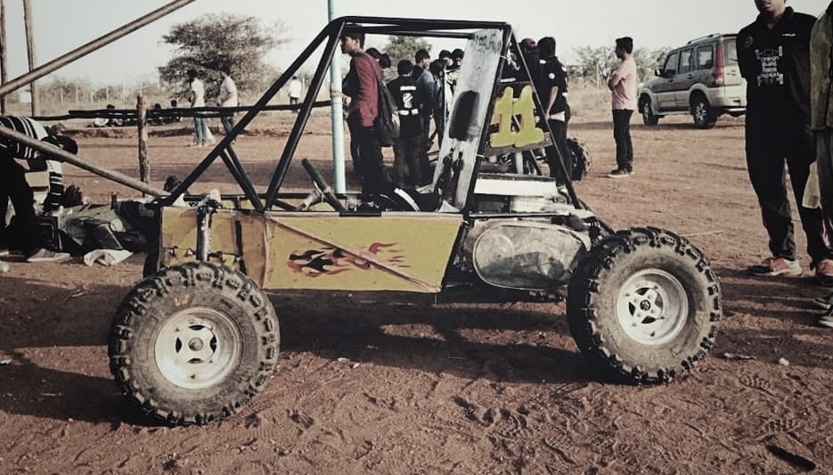
Data Transfer
Long Range
The objective of this project is to send data of various sensors installed in the vehicle to a computer located at some another place a long distance away from the computer continuously and effectively.
The data can be temperature of various components of vehicle, fuel information, GPS location etc.

Slide 2
Data Transfer
LoRa
Long Range
LoRa (from "long range") is a physical proprietary radio communication technique. It is based on spread spectrum modulation techniques derived from chirp spread spectrum (CSS) technology.
1. Long Range: Can transmit up to 20 kms in rural areas and 5 kms in urban settings, making it ideal for wide area loT applications.
2. Low Power: LoRa devices are energy efficient, running on batteries for many years
3. Adaptive Data Rate: Helps in optimizing energy consumption and enhances network capacity.
4. High Capacity: Can support millions of messages per base station, making it an excellent choice for dense sensor networks.
5. Secure: Built-in encryption for secure data transfer
The objective of this project is to send data of various sensors installed in the vehicle to a computer located at some another place a long distance away from the computer continuously and effectively.
The data can be temperature of various components of vehicle, fuel information, GPS location etc.

Slide 3
Data Transfer
LoRa
Long Range
LoRa (from "long range") is a physical proprietary radio communication technique. It is based on spread spectrum modulation techniques derived from chirp spread spectrum (CSS) technology.
1. Long Range: Can transmit up to 20 kms in rural areas and 5 kms in urban settings, making it ideal for wide area loT applications.
2. Low Power: LoRa devices are energy efficient, running on batteries for many years
3. Adaptive Data Rate: Helps in optimizing energy consumption and enhances network capacity.
4. High Capacity: Can support millions of messages per base station, making it an excellent choice for dense sensor networks.
5. Secure: Built-in encryption for secure data transfer
The objective of this project is to send data of various sensors installed in the vehicle to a computer located at some another place a long distance away from the computer continuously and effectively.
The data can be temperature of various components of vehicle, fuel information, GPS location etc.

Slide 4
Data Transfer
Characteristics of LoRa
LoRa
Long Range
LoRa (from "long range") is a physical proprietary radio communication technique. It is based on spread spectrum modulation techniques derived from chirp spread spectrum (CSS) technology.
Modulation | Chirp Spread Spectrum
Frequency | Unlicensed ISM Band (868 MHz)
Bandwidth | 250KHz and 125 KHz
Maximum Data Rate | 50 Kbps
Maximum Payload Length | 243 bytes
Spread Factor | 7 to 12
Coverage Range | 5 Km (Urban); 20 Km (Rural)
Topology | Star on Star
Adaptive Data Rate | Yes
Authentication/Encryption | Yes (AES 128b)
Allow Private Network | Yes
Standardization | LoRa-Alliance (Governing Body)
1. Long Range: Can transmit up to 20 kms in rural areas and 5 kms in urban settings, making it ideal for wide area loT applications.
2. Low Power: LoRa devices are energy efficient, running on batteries for many years
3. Adaptive Data Rate: Helps in optimizing energy consumption and enhances network capacity.
4. High Capacity: Can support millions of messages per base station, making it an excellent choice for dense sensor networks.
5. Secure: Built-in encryption for secure data transfer
The objective of this project is to send data of various sensors installed in the vehicle to a computer located at some another place a long distance away from the computer continuously and effectively.
The data can be temperature of various components of vehicle, fuel information, GPS location etc.

Slide 5
Characteristics of LoRa
LoRa
Data Transfer
Long Range
LoRa (from "long range") is a physical proprietary radio communication technique. It is based on spread spectrum modulation techniques derived from chirp spread spectrum (CSS) technology.
Modulation | Chirp Spread Spectrum
Frequency | Unlicensed ISM Band (868 MHz)
Bandwidth | 250KHz and 125 KHz
Maximum Data Rate | 50 Kbps
Maximum Payload Length | 243 bytes
Spread Factor | 7 to 12
Coverage Range | 5 Km (Urban); 20 Km (Rural)
Topology | Star on Star
Adaptive Data Rate | Yes
Authentication/Encryption | Yes (AES 128b)
Allow Private Network | Yes
Standardization | LoRa-Alliance (Governing Body)
1. Long Range: Can transmit up to 20 kms in rural areas and 5 kms in urban settings, making it ideal for wide area loT applications.
2. Low Power: LoRa devices are energy efficient, running on batteries for many years
3. Adaptive Data Rate: Helps in optimizing energy consumption and enhances network capacity.
4. High Capacity: Can support millions of messages per base station, making it an excellent choice for dense sensor networks.
5. Secure: Built-in encryption for secure data transfer
The objective of this project is to send data of various sensors installed in the vehicle to a computer located at some another place a long distance away from the computer continuously and effectively.
The data can be temperature of various components of vehicle, fuel information, GPS location etc.

Slide 6
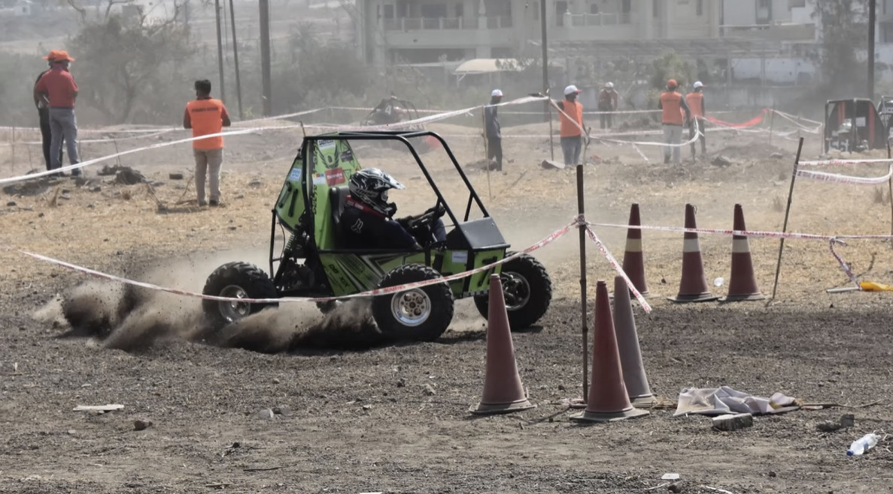
Characteristics of LoRa
Components Required for Data Transfer
LoRa
Data Transfer
Long Range
LoRa (from "long range") is a physical proprietary radio communication technique. It is based on spread spectrum modulation techniques derived from chirp spread spectrum (CSS) technology.
Modulation | Chirp Spread Spectrum
Frequency | Unlicensed ISM Band (868 MHz)
Bandwidth | 250KHz and 125 KHz
Maximum Data Rate | 50 Kbps
Maximum Payload Length | 243 bytes
Spread Factor | 7 to 12
Coverage Range | 5 Km (Urban); 20 Km (Rural)
Topology | Star on Star
Adaptive Data Rate | Yes
Authentication/Encryption | Yes (AES 128b)
Allow Private Network | Yes
Standardization | LoRa-Alliance (Governing Body)
1. Long Range: Can transmit up to 20 kms in rural areas and 5 kms in urban settings, making it ideal for wide area loT applications.
2. Low Power: LoRa devices are energy efficient, running on batteries for many years
3. Adaptive Data Rate: Helps in optimizing energy consumption and enhances network capacity.
4. High Capacity: Can support millions of messages per base station, making it an excellent choice for dense sensor networks.
5. Secure: Built-in encryption for secure data transfer
The objective of this project is to send data of various sensors installed in the vehicle to a computer located at some another place a long distance away from the computer continuously and effectively.
The data can be temperature of various components of vehicle, fuel information, GPS location etc.

Slide 7
Components Required for Data Transfer
Characteristics of LoRa
LoRa
Data Transfer
Long Range
LoRa (from "long range") is a physical proprietary radio communication technique. It is based on spread spectrum modulation techniques derived from chirp spread spectrum (CSS) technology.
Modulation | Chirp Spread Spectrum
Frequency | Unlicensed ISM Band (868 MHz)
Bandwidth | 250KHz and 125 KHz
Maximum Data Rate | 50 Kbps
Maximum Payload Length | 243 bytes
Spread Factor | 7 to 12
Coverage Range | 5 Km (Urban); 20 Km (Rural)
Topology | Star on Star
Adaptive Data Rate | Yes
Authentication/Encryption | Yes (AES 128b)
Allow Private Network | Yes
Standardization | LoRa-Alliance (Governing Body)
1. Long Range: Can transmit up to 20 kms in rural areas and 5 kms in urban settings, making it ideal for wide area loT applications.
2. Low Power: LoRa devices are energy efficient, running on batteries for many years
3. Adaptive Data Rate: Helps in optimizing energy consumption and enhances network capacity.
4. High Capacity: Can support millions of messages per base station, making it an excellent choice for dense sensor networks.
5. Secure: Built-in encryption for secure data transfer
The objective of this project is to send data of various sensors installed in the vehicle to a computer located at some another place a long distance away from the computer continuously and effectively.
The data can be temperature of various components of vehicle, fuel information, GPS location etc.

Slide 8
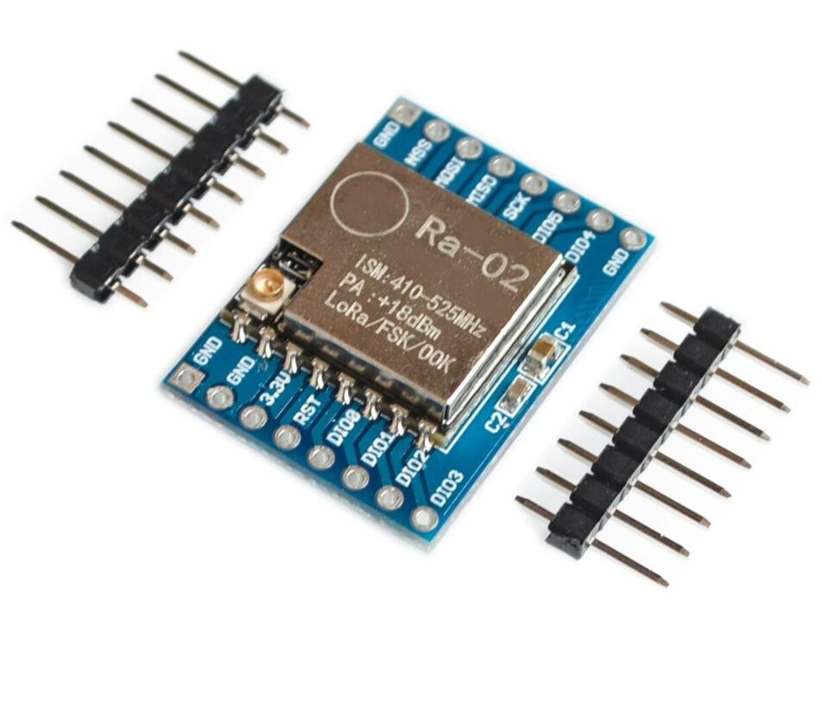

Components Required for Data Transfer
Characteristics of LoRa
LoRa
Data Transfer
Long Range
LoRa (from "long range") is a physical proprietary radio communication technique. It is based on spread spectrum modulation techniques derived from chirp spread spectrum (CSS) technology.
Modulation | Chirp Spread Spectrum
Frequency | Unlicensed ISM Band (868 MHz)
Bandwidth | 250KHz and 125 KHz
Maximum Data Rate | 50 Kbps
Maximum Payload Length | 243 bytes
Spread Factor | 7 to 12
Coverage Range | 5 Km (Urban); 20 Km (Rural)
Topology | Star on Star
Adaptive Data Rate | Yes
Authentication/Encryption | Yes (AES 128b)
Allow Private Network | Yes
Standardization | LoRa-Alliance (Governing Body)
1. Long Range: Can transmit up to 20 kms in rural areas and 5 kms in urban settings, making it ideal for wide area loT applications.
2. Low Power: LoRa devices are energy efficient, running on batteries for many years
3. Adaptive Data Rate: Helps in optimizing energy consumption and enhances network capacity.
4. High Capacity: Can support millions of messages per base station, making it an excellent choice for dense sensor networks.
5. Secure: Built-in encryption for secure data transfer
The objective of this project is to send data of various sensors installed in the vehicle to a computer located at some another place a long distance away from the computer continuously and effectively.
The data can be temperature of various components of vehicle, fuel information, GPS location etc.
Long Range
LoRa (from "long range") is a physical proprietary radio communication technique. It is based on spread spectrum modulation techniques derived from chirp spread spectrum (CSS) technology.
Modulation | Chirp Spread Spectrum
Frequency | Unlicensed ISM Band (868 MHz)
Bandwidth | 250KHz and 125 KHz
Maximum Data Rate | 50 Kbps
Maximum Payload Length | 243 bytes
Spread Factor | 7 to 12
Coverage Range | 5 Km (Urban); 20 Km (Rural)
Topology | Star on Star
Adaptive Data Rate | Yes
Authentication/Encryption | Yes (AES 128b)
Allow Private Network | Yes
Standardization | LoRa-Alliance (Governing Body)
1. Long Range: Can transmit up to 20 kms in rural areas and 5 kms in urban settings, making it ideal for wide area loT applications.
2. Low Power: LoRa devices are energy efficient, running on batteries for many years
3. Adaptive Data Rate: Helps in optimizing energy consumption and enhances network capacity.
4. High Capacity: Can support millions of messages per base station, making it an excellent choice for dense sensor networks.
5. Secure: Built-in encryption for secure data transfer
The data can be temperature of various components of vehicle, fuel information, GPS location etc.
The objective of this project is to send data of various sensors installed in the vehicle to a computer located at some another place a long distance away from the computer continuously and effectively.
Two SX1278 LoRa Transceivers
The SX1278 transceivers feature the LoRa long range modem that provides ultra-long range spread spectrum communication and high interference immunity whilst minimizing current consumption. One will be connected to the microcontroller which is placed in the vehicle to take in the data from different sensors and one will be connected to the computer at work station.
It costs about ₹400 to 500
LoRa module product link
Helix antenna product link
The data can be temperature of various components of vehicle, fuel information, GPS location etc.
Arduino Uno
Arduino UNO is a microcontroller board. It has 14 digital input/output pins (of which 6 can be used as PWM outputs), 6 analog inputs, a 16 MHz ceramic resonator, a USB connection, a power jack, an ICSP header and a reset button. It will be placed in the vehicle and various sensors and one LoRa transceiver will be connected to it. The transceiver will act as transmitter and will send data to the other transciever.
It costs about ₹300 to 400
Arduino Uno product link

Slide 9
Components Required for Data Transfer
Characteristics of LoRa
LoRa
Data Transfer
Long Range
LoRa (from "long range") is a physical proprietary radio communication technique. It is based on spread spectrum modulation techniques derived from chirp spread spectrum (CSS) technology.
Modulation | Chirp Spread Spectrum
Frequency | Unlicensed ISM Band (868 MHz)
Bandwidth | 250KHz and 125 KHz
Maximum Data Rate | 50 Kbps
Maximum Payload Length | 243 bytes
Spread Factor | 7 to 12
Coverage Range | 5 Km (Urban); 20 Km (Rural)
Topology | Star on Star
Adaptive Data Rate | Yes
Authentication/Encryption | Yes (AES 128b)
Allow Private Network | Yes
Standardization | LoRa-Alliance (Governing Body)
1. Long Range: Can transmit up to 20 kms in rural areas and 5 kms in urban settings, making it ideal for wide area loT applications.
2. Low Power: LoRa devices are energy efficient, running on batteries for many years
3. Adaptive Data Rate: Helps in optimizing energy consumption and enhances network capacity.
4. High Capacity: Can support millions of messages per base station, making it an excellent choice for dense sensor networks.
5. Secure: Built-in encryption for secure data transfer
The objective of this project is to send data of various sensors installed in the vehicle to a computer located at some another place a long distance away from the computer continuously and effectively.
The data can be temperature of various components of vehicle, fuel information, GPS location etc.
Two SX1278 LoRa Transceivers
Arduino Uno
The SX1278 transceivers feature the LoRa long range modem that provides ultra-long range spread spectrum communication and high interference immunity whilst minimizing current consumption. One will be connected to the microcontroller which is placed in the vehicle to take in the data from different sensors and one will be connected to the computer at work station.
It costs about ₹400 to 500
LoRa module product link
Helix antenna product link
Arduino UNO is a microcontroller board. It has 14 digital input/output pins (of which 6 can be used as PWM outputs), 6 analog inputs, a 16 MHz ceramic resonator, a USB connection, a power jack, an ICSP header and a reset button. It will be placed in the vehicle and various sensors and one LoRa transceiver will be connected to it. The transceiver will act as transmitter and will send data to the other transciever.
It costs about ₹300 to 400
Arduino Uno product link

Slide 10

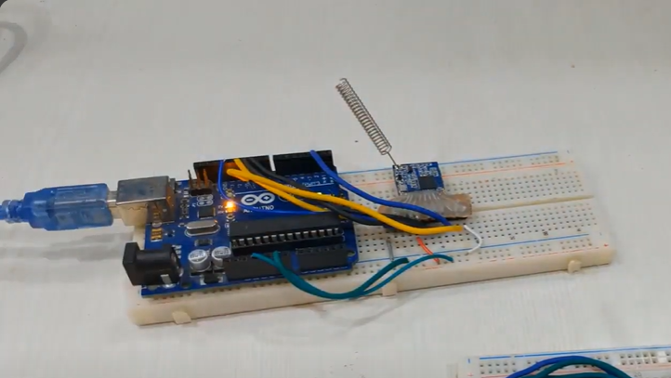
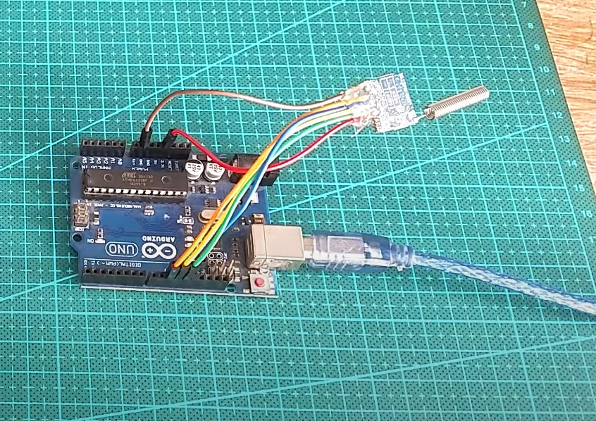


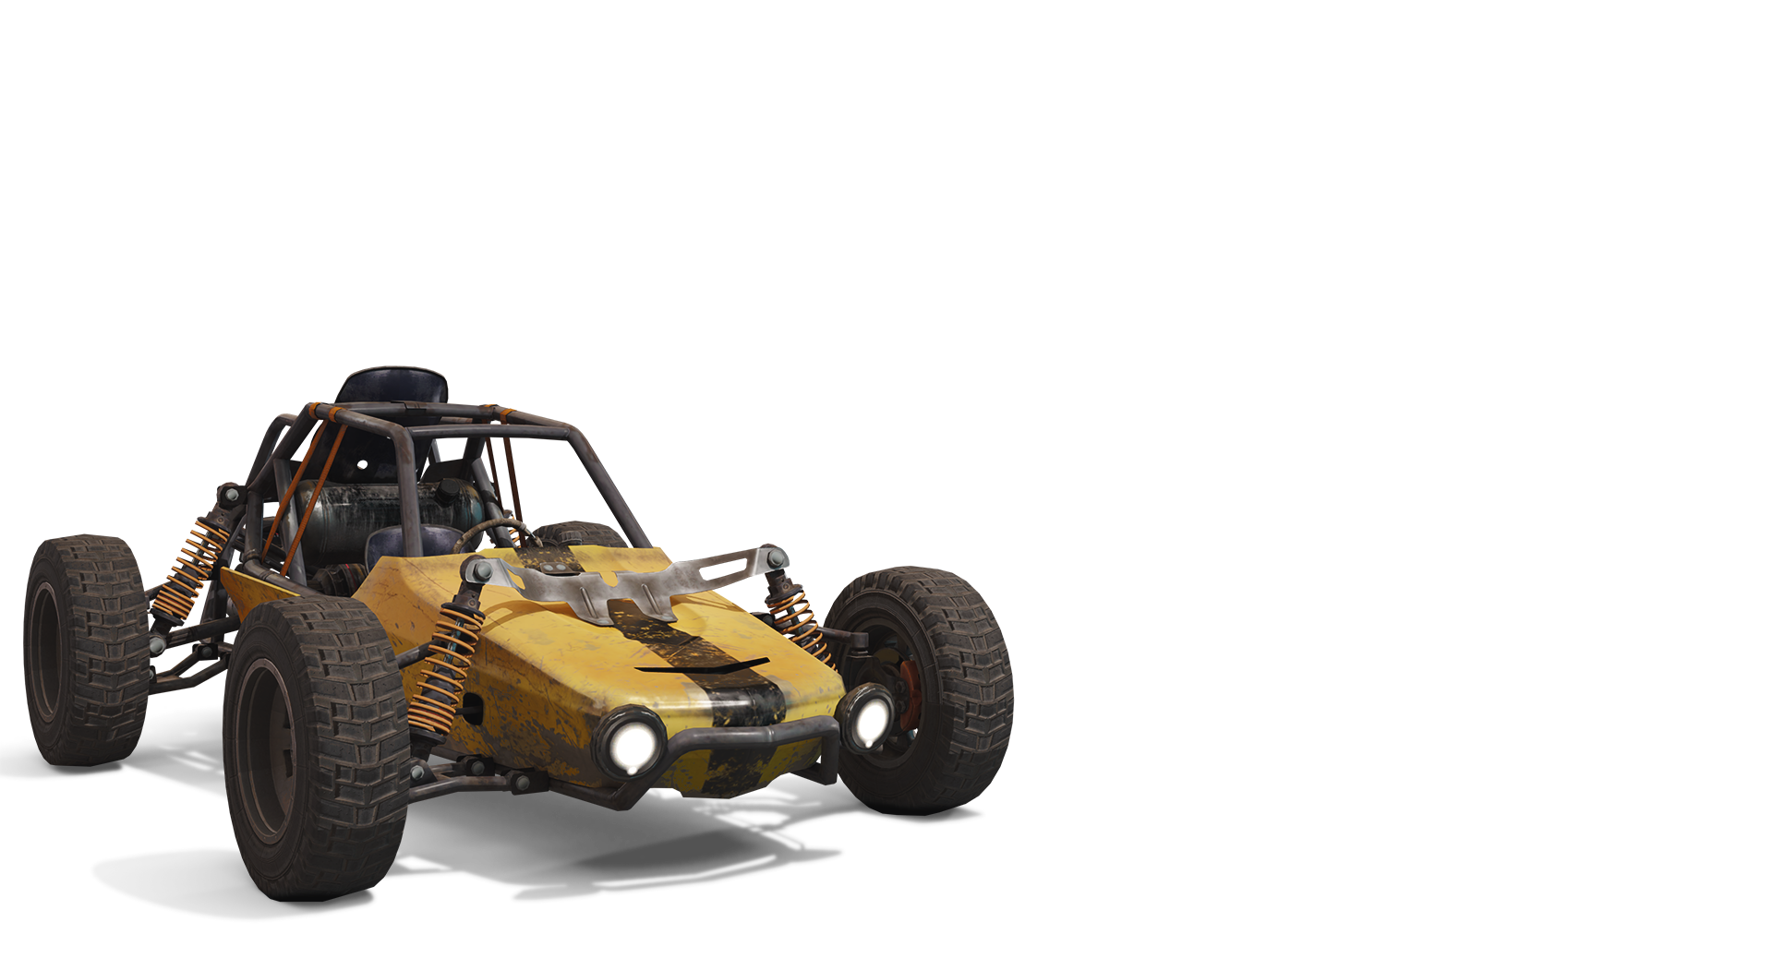
Components Required for Data Transfer
Characteristics of LoRa
LoRa
Data Transfer
Long Range
Arduino Uno with one transceiver and various sensor inside the vehicle
LoRa (from "long range") is a physical proprietary radio communication technique. It is based on spread spectrum modulation techniques derived from chirp spread spectrum (CSS) technology.
Another Arduino Uno connected with PC and one transceiver
Modulation | Chirp Spread Spectrum
Frequency | Unlicensed ISM Band (868 MHz)
Bandwidth | 250KHz and 125 KHz
Maximum Data Rate | 50 Kbps
Maximum Payload Length | 243 bytes
Spread Factor | 7 to 12
Coverage Range | 5 Km (Urban); 20 Km (Rural)
Topology | Star on Star
Adaptive Data Rate | Yes
Authentication/Encryption | Yes (AES 128b)
Allow Private Network | Yes
Standardization | LoRa-Alliance (Governing Body)
1. Long Range: Can transmit up to 20 kms in rural areas and 5 kms in urban settings, making it ideal for wide area loT applications.
2. Low Power: LoRa devices are energy efficient, running on batteries for many years
3. Adaptive Data Rate: Helps in optimizing energy consumption and enhances network capacity.
4. High Capacity: Can support millions of messages per base station, making it an excellent choice for dense sensor networks.
5. Secure: Built-in encryption for secure data transfer
The objective of this project is to send data of various sensors installed in the vehicle to a computer located at some another place a long distance away from the computer continuously and effectively.
The data can be temperature of various components of vehicle, fuel information, GPS location etc.
Two SX1278 LoRa Transceivers
Arduino Uno
The SX1278 transceivers feature the LoRa long range modem that provides ultra-long range spread spectrum communication and high interference immunity whilst minimizing current consumption. One will be connected to the microcontroller which is placed in the vehicle to take in the data from different sensors and one will be connected to the computer at work station.
It costs about ₹400 to 500
LoRa module product link
Helix antenna product link
Arduino UNO is a microcontroller board. It has 14 digital input/output pins (of which 6 can be used as PWM outputs), 6 analog inputs, a 16 MHz ceramic resonator, a USB connection, a power jack, an ICSP header and a reset button. It will be placed in the vehicle and various sensors and one LoRa transceiver will be connected to it. The transceiver will act as transmitter and will send data to the other transciever.
It costs about ₹300 to 400
Arduino Uno product link

Slide 11
Components Required for Data Transfer
Characteristics of LoRa
LoRa
Data Transfer
Arduino Uno with one transceiver and various sensor inside the vehicle
Long Range
LoRa (from "long range") is a physical proprietary radio communication technique. It is based on spread spectrum modulation techniques derived from chirp spread spectrum (CSS) technology.
Another Arduino Uno connected with PC and one transceiver
Modulation | Chirp Spread Spectrum
Frequency | Unlicensed ISM Band (868 MHz)
Bandwidth | 250KHz and 125 KHz
Maximum Data Rate | 50 Kbps
Maximum Payload Length | 243 bytes
Spread Factor | 7 to 12
Coverage Range | 5 Km (Urban); 20 Km (Rural)
Topology | Star on Star
Adaptive Data Rate | Yes
Authentication/Encryption | Yes (AES 128b)
Allow Private Network | Yes
Standardization | LoRa-Alliance (Governing Body)
1. Long Range: Can transmit up to 20 kms in rural areas and 5 kms in urban settings, making it ideal for wide area loT applications.
2. Low Power: LoRa devices are energy efficient, running on batteries for many years
3. Adaptive Data Rate: Helps in optimizing energy consumption and enhances network capacity.
4. High Capacity: Can support millions of messages per base station, making it an excellent choice for dense sensor networks.
5. Secure: Built-in encryption for secure data transfer
The objective of this project is to send data of various sensors installed in the vehicle to a computer located at some another place a long distance away from the computer continuously and effectively.
The data can be temperature of various components of vehicle, fuel information, GPS location etc.
Two SX1278 LoRa Transceivers
Arduino Uno
The SX1278 transceivers feature the LoRa long range modem that provides ultra-long range spread spectrum communication and high interference immunity whilst minimizing current consumption. One will be connected to the microcontroller which is placed in the vehicle to take in the data from different sensors and one will be connected to the computer at work station.
It costs about ₹400 to 500
LoRa module product link
Helix antenna product link
Arduino UNO is a microcontroller board. It has 14 digital input/output pins (of which 6 can be used as PWM outputs), 6 analog inputs, a 16 MHz ceramic resonator, a USB connection, a power jack, an ICSP header and a reset button. It will be placed in the vehicle and various sensors and one LoRa transceiver will be connected to it. The transceiver will act as transmitter and will send data to the other transciever.
It costs about ₹300 to 400
Arduino Uno product link

Slide 12
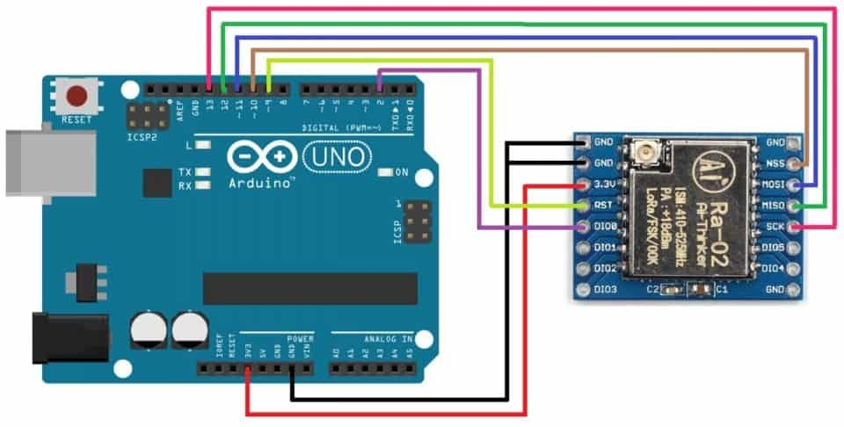
Components Required for Data Transfer
Characteristics of LoRa
Rough Sketch of Wiring
LoRa
Data Transfer
Arduino Uno with one transceiver and various sensor inside the vehicle
Long Range
LoRa (from "long range") is a physical proprietary radio communication technique. It is based on spread spectrum modulation techniques derived from chirp spread spectrum (CSS) technology.
Another Arduino Uno connected with PC and one transceiver
Modulation | Chirp Spread Spectrum
Frequency | Unlicensed ISM Band (868 MHz)
Bandwidth | 250KHz and 125 KHz
Maximum Data Rate | 50 Kbps
Maximum Payload Length | 243 bytes
Spread Factor | 7 to 12
Coverage Range | 5 Km (Urban); 20 Km (Rural)
Topology | Star on Star
Adaptive Data Rate | Yes
Authentication/Encryption | Yes (AES 128b)
Allow Private Network | Yes
Standardization | LoRa-Alliance (Governing Body)
LoRa VCC to Arduino 3.3V or an external 3.3V power supply (check the module's voltage requirements).
​LoRa GND to Arduino GND.​
LoRa SCK to Arduino SCK, 13 (SCK is the SPI clock pin).​
LoRa MISO to Arduino MISO, 12(Master In Slave Out).​
LoRa MOSI to Arduino MOSI, 11 (Master Out Slave In).
​LoRa NSS (or CS) to an Arduino digital pin (e.g., D10).
​LoRa DIO0 to an Arduino digital pin (e.g., D2) - this is the interrupt pin used to receive data.​
LoRa RST (Reset) to an Arduino digital pin (e.g., D9) if available; otherwise, you can connect it directly to 3.3V.​
1. Long Range: Can transmit up to 20 kms in rural areas and 5 kms in urban settings, making it ideal for wide area loT applications.
2. Low Power: LoRa devices are energy efficient, running on batteries for many years
3. Adaptive Data Rate: Helps in optimizing energy consumption and enhances network capacity.
4. High Capacity: Can support millions of messages per base station, making it an excellent choice for dense sensor networks.
5. Secure: Built-in encryption for secure data transfer
The objective of this project is to send data of various sensors installed in the vehicle to a computer located at some another place a long distance away from the computer continuously and effectively.
The data can be temperature of various components of vehicle, fuel information, GPS location etc.
Two SX1278 LoRa Transceivers
Arduino Uno
The SX1278 transceivers feature the LoRa long range modem that provides ultra-long range spread spectrum communication and high interference immunity whilst minimizing current consumption. One will be connected to the microcontroller which is placed in the vehicle to take in the data from different sensors and one will be connected to the computer at work station.
It costs about ₹400 to 500
LoRa module product link
Helix antenna product link
Arduino UNO is a microcontroller board. It has 14 digital input/output pins (of which 6 can be used as PWM outputs), 6 analog inputs, a 16 MHz ceramic resonator, a USB connection, a power jack, an ICSP header and a reset button. It will be placed in the vehicle and various sensors and one LoRa transceiver will be connected to it. The transceiver will act as transmitter and will send data to the other transciever.
It costs about ₹300 to 400
Arduino Uno product link

Slide 13
Components Required for Data Transfer
Characteristics of LoRa
Rough Sketch of Wiring
LoRa
Data Transfer
Arduino Uno with one transceiver and various sensor inside the vehicle
Long Range
LoRa (from "long range") is a physical proprietary radio communication technique. It is based on spread spectrum modulation techniques derived from chirp spread spectrum (CSS) technology.
Another Arduino Uno connected with PC and one transceiver
Modulation | Chirp Spread Spectrum
Frequency | Unlicensed ISM Band (868 MHz)
Bandwidth | 250KHz and 125 KHz
Maximum Data Rate | 50 Kbps
Maximum Payload Length | 243 bytes
Spread Factor | 7 to 12
Coverage Range | 5 Km (Urban); 20 Km (Rural)
Topology | Star on Star
Adaptive Data Rate | Yes
Authentication/Encryption | Yes (AES 128b)
Allow Private Network | Yes
Standardization | LoRa-Alliance (Governing Body)
LoRa VCC to Arduino 3.3V or an external 3.3V power supply (check the module's voltage requirements).
​LoRa GND to Arduino GND.​
LoRa SCK to Arduino SCK, 13 (SCK is the SPI clock pin).​
LoRa MISO to Arduino MISO, 12(Master In Slave Out).​
LoRa MOSI to Arduino MOSI, 11 (Master Out Slave In).
​LoRa NSS (or CS) to an Arduino digital pin (e.g., D10).
​LoRa DIO0 to an Arduino digital pin (e.g., D2) - this is the interrupt pin used to receive data.​
LoRa RST (Reset) to an Arduino digital pin (e.g., D9) if available; otherwise, you can connect it directly to 3.3V.​
1. Long Range: Can transmit up to 20 kms in rural areas and 5 kms in urban settings, making it ideal for wide area loT applications.
2. Low Power: LoRa devices are energy efficient, running on batteries for many years
3. Adaptive Data Rate: Helps in optimizing energy consumption and enhances network capacity.
4. High Capacity: Can support millions of messages per base station, making it an excellent choice for dense sensor networks.
5. Secure: Built-in encryption for secure data transfer
The objective of this project is to send data of various sensors installed in the vehicle to a computer located at some another place a long distance away from the computer continuously and effectively.
The data can be temperature of various components of vehicle, fuel information, GPS location etc.
Two SX1278 LoRa Transceivers
Arduino Uno
The SX1278 transceivers feature the LoRa long range modem that provides ultra-long range spread spectrum communication and high interference immunity whilst minimizing current consumption. One will be connected to the microcontroller which is placed in the vehicle to take in the data from different sensors and one will be connected to the computer at work station.
It costs about ₹400 to 500
LoRa module product link
Helix antenna product link
Arduino UNO is a microcontroller board. It has 14 digital input/output pins (of which 6 can be used as PWM outputs), 6 analog inputs, a 16 MHz ceramic resonator, a USB connection, a power jack, an ICSP header and a reset button. It will be placed in the vehicle and various sensors and one LoRa transceiver will be connected to it. The transceiver will act as transmitter and will send data to the other transciever.
It costs about ₹300 to 400
Arduino Uno product link

Slide 14
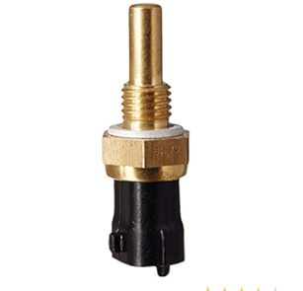
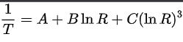
Components Required for Data Transfer
Coolant Sensor
Characteristics of LoRa
Rough Sketch of Wiring
LoRa
Data Transfer
Arduino Uno with one transceiver and various sensor inside the vehicle
Long Range
LoRa (from "long range") is a physical proprietary radio communication technique. It is based on spread spectrum modulation techniques derived from chirp spread spectrum (CSS) technology.
It is a sensor that is used to measure the temperature of vehicle around engine.
It doesn’t directly measure the temperature.
We first find the resistance dependent of it with temperature then use voltage divider circuit with Arduino to calculate the temperature by Steinhart–Hart equation.
Another Arduino Uno connected with PC and one transceiver
Modulation | Chirp Spread Spectrum
Frequency | Unlicensed ISM Band (868 MHz)
Bandwidth | 250KHz and 125 KHz
Maximum Data Rate | 50 Kbps
Maximum Payload Length | 243 bytes
Spread Factor | 7 to 12
Coverage Range | 5 Km (Urban); 20 Km (Rural)
Topology | Star on Star
Adaptive Data Rate | Yes
Authentication/Encryption | Yes (AES 128b)
Allow Private Network | Yes
Standardization | LoRa-Alliance (Governing Body)
LoRa VCC to Arduino 3.3V or an external 3.3V power supply (check the module's voltage requirements).
​LoRa GND to Arduino GND.​
LoRa SCK to Arduino SCK, 13 (SCK is the SPI clock pin).​
LoRa MISO to Arduino MISO, 12(Master In Slave Out).​
LoRa MOSI to Arduino MOSI, 11 (Master Out Slave In).
​LoRa NSS (or CS) to an Arduino digital pin (e.g., D10).
​LoRa DIO0 to an Arduino digital pin (e.g., D2) - this is the interrupt pin used to receive data.​
LoRa RST (Reset) to an Arduino digital pin (e.g., D9) if available; otherwise, you can connect it directly to 3.3V.​
1. Long Range: Can transmit up to 20 kms in rural areas and 5 kms in urban settings, making it ideal for wide area loT applications.
2. Low Power: LoRa devices are energy efficient, running on batteries for many years
3. Adaptive Data Rate: Helps in optimizing energy consumption and enhances network capacity.
4. High Capacity: Can support millions of messages per base station, making it an excellent choice for dense sensor networks.
5. Secure: Built-in encryption for secure data transfer
The objective of this project is to send data of various sensors installed in the vehicle to a computer located at some another place a long distance away from the computer continuously and effectively.
The data can be temperature of various components of vehicle, fuel information, GPS location etc.
Two SX1278 LoRa Transceivers
Arduino Uno
The SX1278 transceivers feature the LoRa long range modem that provides ultra-long range spread spectrum communication and high interference immunity whilst minimizing current consumption. One will be connected to the microcontroller which is placed in the vehicle to take in the data from different sensors and one will be connected to the computer at work station.
It costs about ₹400 to 500
LoRa module product link
Helix antenna product link
Arduino UNO is a microcontroller board. It has 14 digital input/output pins (of which 6 can be used as PWM outputs), 6 analog inputs, a 16 MHz ceramic resonator, a USB connection, a power jack, an ICSP header and a reset button. It will be placed in the vehicle and various sensors and one LoRa transceiver will be connected to it. The transceiver will act as transmitter and will send data to the other transciever.
It costs about ₹300 to 400
Arduino Uno product link
We find resistance at 0,22 and 100 degree Celsius to find the constants A,B,C and then use voltage divider circuit with Arduino to calculate resistor and then find the temperature finally.

Slide 15
Coolant Sensor
Components Required for Data Transfer
Characteristics of LoRa
Rough Sketch of Wiring
LoRa
Data Transfer
Arduino Uno with one transceiver and various sensor inside the vehicle
It is a sensor that is used to measure the temperature of vehicle around engine.
It doesn’t directly measure the temperature.
We first find the resistance dependent of it with temperature then use voltage divider circuit with Arduino to calculate the temperature by Steinhart–Hart equation.
Long Range
LoRa (from "long range") is a physical proprietary radio communication technique. It is based on spread spectrum modulation techniques derived from chirp spread spectrum (CSS) technology.
Another Arduino Uno connected with PC and one transceiver
Modulation | Chirp Spread Spectrum
Frequency | Unlicensed ISM Band (868 MHz)
Bandwidth | 250KHz and 125 KHz
Maximum Data Rate | 50 Kbps
Maximum Payload Length | 243 bytes
Spread Factor | 7 to 12
Coverage Range | 5 Km (Urban); 20 Km (Rural)
Topology | Star on Star
Adaptive Data Rate | Yes
Authentication/Encryption | Yes (AES 128b)
Allow Private Network | Yes
Standardization | LoRa-Alliance (Governing Body)
LoRa VCC to Arduino 3.3V or an external 3.3V power supply (check the module's voltage requirements).
​LoRa GND to Arduino GND.​
LoRa SCK to Arduino SCK, 13 (SCK is the SPI clock pin).​
LoRa MISO to Arduino MISO, 12(Master In Slave Out).​
LoRa MOSI to Arduino MOSI, 11 (Master Out Slave In).
​LoRa NSS (or CS) to an Arduino digital pin (e.g., D10).
​LoRa DIO0 to an Arduino digital pin (e.g., D2) - this is the interrupt pin used to receive data.​
LoRa RST (Reset) to an Arduino digital pin (e.g., D9) if available; otherwise, you can connect it directly to 3.3V.​
1. Long Range: Can transmit up to 20 kms in rural areas and 5 kms in urban settings, making it ideal for wide area loT applications.
2. Low Power: LoRa devices are energy efficient, running on batteries for many years
3. Adaptive Data Rate: Helps in optimizing energy consumption and enhances network capacity.
4. High Capacity: Can support millions of messages per base station, making it an excellent choice for dense sensor networks.
5. Secure: Built-in encryption for secure data transfer
The objective of this project is to send data of various sensors installed in the vehicle to a computer located at some another place a long distance away from the computer continuously and effectively.
The data can be temperature of various components of vehicle, fuel information, GPS location etc.
Two SX1278 LoRa Transceivers
Arduino Uno
The SX1278 transceivers feature the LoRa long range modem that provides ultra-long range spread spectrum communication and high interference immunity whilst minimizing current consumption. One will be connected to the microcontroller which is placed in the vehicle to take in the data from different sensors and one will be connected to the computer at work station.
It costs about ₹400 to 500
LoRa module product link
Helix antenna product link
Arduino UNO is a microcontroller board. It has 14 digital input/output pins (of which 6 can be used as PWM outputs), 6 analog inputs, a 16 MHz ceramic resonator, a USB connection, a power jack, an ICSP header and a reset button. It will be placed in the vehicle and various sensors and one LoRa transceiver will be connected to it. The transceiver will act as transmitter and will send data to the other transciever.
It costs about ₹300 to 400
Arduino Uno product link
We find resistance at 0,22 and 100 degree Celsius to find the constants A,B,C and then use voltage divider circuit with Arduino to calculate resistor and then find the temperature finally.

Slide 16
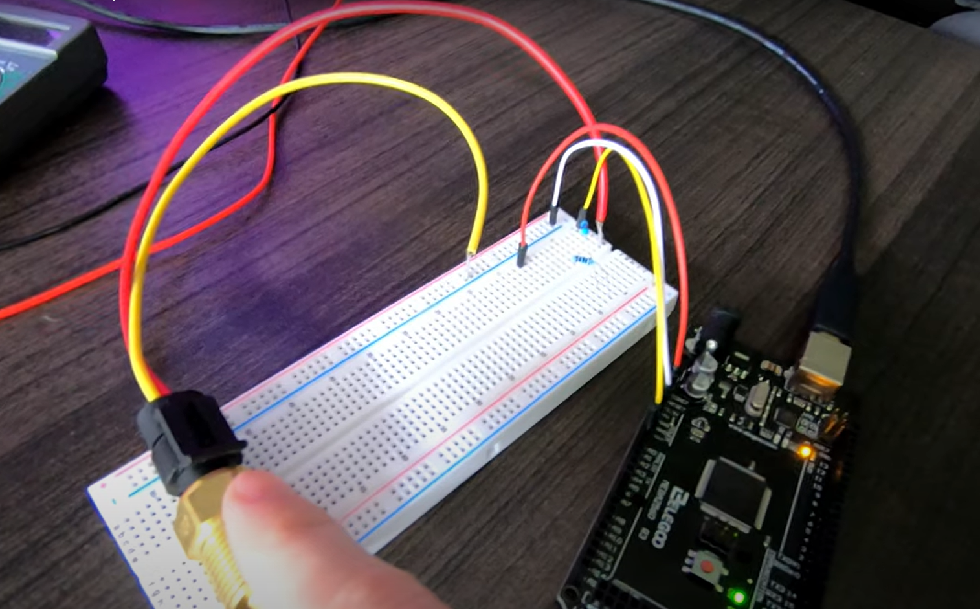
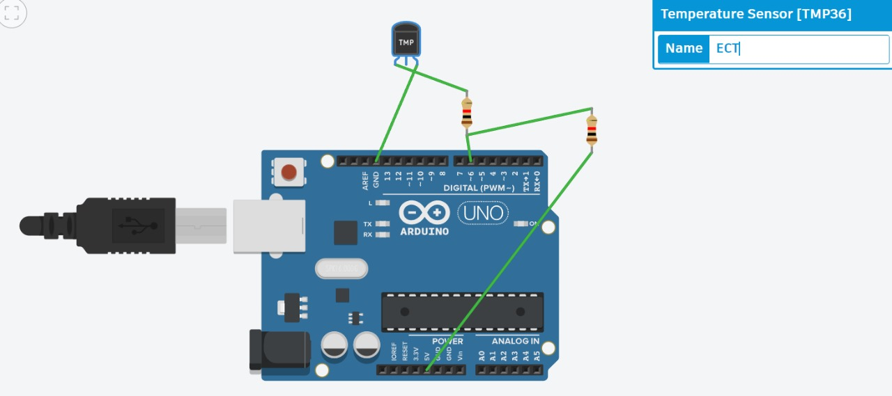
Coolant Sensor
Components Required for Data Transfer
Characteristics of LoRa
Wiring
Rough Sketch of Wiring
LoRa
Data Transfer
Arduino Uno with one transceiver and various sensor inside the vehicle
It is a sensor that is used to measure the temperature of vehicle around engine.
It doesn’t directly measure the temperature.
We first find the resistance dependent of it with temperature then use voltage divider circuit with Arduino to calculate the temperature by Steinhart–Hart equation.
Long Range
LoRa (from "long range") is a physical proprietary radio communication technique. It is based on spread spectrum modulation techniques derived from chirp spread spectrum (CSS) technology.
Another Arduino Uno connected with PC and one transceiver
Modulation | Chirp Spread Spectrum
Frequency | Unlicensed ISM Band (868 MHz)
Bandwidth | 250KHz and 125 KHz
Maximum Data Rate | 50 Kbps
Maximum Payload Length | 243 bytes
Spread Factor | 7 to 12
Coverage Range | 5 Km (Urban); 20 Km (Rural)
Topology | Star on Star
Adaptive Data Rate | Yes
Authentication/Encryption | Yes (AES 128b)
Allow Private Network | Yes
Standardization | LoRa-Alliance (Governing Body)
LoRa VCC to Arduino 3.3V or an external 3.3V power supply (check the module's voltage requirements).
​LoRa GND to Arduino GND.​
LoRa SCK to Arduino SCK, 13 (SCK is the SPI clock pin).​
LoRa MISO to Arduino MISO, 12(Master In Slave Out).​
LoRa MOSI to Arduino MOSI, 11 (Master Out Slave In).
​LoRa NSS (or CS) to an Arduino digital pin (e.g., D10).
​LoRa DIO0 to an Arduino digital pin (e.g., D2) - this is the interrupt pin used to receive data.​
LoRa RST (Reset) to an Arduino digital pin (e.g., D9) if available; otherwise, you can connect it directly to 3.3V.​
1. Long Range: Can transmit up to 20 kms in rural areas and 5 kms in urban settings, making it ideal for wide area loT applications.
2. Low Power: LoRa devices are energy efficient, running on batteries for many years
3. Adaptive Data Rate: Helps in optimizing energy consumption and enhances network capacity.
4. High Capacity: Can support millions of messages per base station, making it an excellent choice for dense sensor networks.
5. Secure: Built-in encryption for secure data transfer
The objective of this project is to send data of various sensors installed in the vehicle to a computer located at some another place a long distance away from the computer continuously and effectively.
The data can be temperature of various components of vehicle, fuel information, GPS location etc.
Two SX1278 LoRa Transceivers
Arduino Uno
The SX1278 transceivers feature the LoRa long range modem that provides ultra-long range spread spectrum communication and high interference immunity whilst minimizing current consumption. One will be connected to the microcontroller which is placed in the vehicle to take in the data from different sensors and one will be connected to the computer at work station.
It costs about ₹400 to 500
LoRa module product link
Helix antenna product link
Arduino UNO is a microcontroller board. It has 14 digital input/output pins (of which 6 can be used as PWM outputs), 6 analog inputs, a 16 MHz ceramic resonator, a USB connection, a power jack, an ICSP header and a reset button. It will be placed in the vehicle and various sensors and one LoRa transceiver will be connected to it. The transceiver will act as transmitter and will send data to the other transciever.
It costs about ₹300 to 400
Arduino Uno product link
We find resistance at 0,22 and 100 degree Celsius to find the constants A,B,C and then use voltage divider circuit with Arduino to calculate resistor and then find the temperature finally.
ECT has two wires, one of them will be connected to the ground and the second will be connected by the voltage-dividend. The above resistors have the values of difference of individual resistances across the wires.
ECT web address

Slide 17
Coolant Sensor
Components Required for Data Transfer
Characteristics of LoRa
Wiring
Rough Sketch of Wiring
LoRa
Data Transfer
Arduino Uno with one transceiver and various sensor inside the vehicle
It is a sensor that is used to measure the temperature of vehicle around engine.
It doesn’t directly measure the temperature.
We first find the resistance dependent of it with temperature then use voltage divider circuit with Arduino to calculate the temperature by Steinhart–Hart equation.
Long Range
LoRa (from "long range") is a physical proprietary radio communication technique. It is based on spread spectrum modulation techniques derived from chirp spread spectrum (CSS) technology.
Another Arduino Uno connected with PC and one transceiver
Modulation | Chirp Spread Spectrum
Frequency | Unlicensed ISM Band (868 MHz)
Bandwidth | 250KHz and 125 KHz
Maximum Data Rate | 50 Kbps
Maximum Payload Length | 243 bytes
Spread Factor | 7 to 12
Coverage Range | 5 Km (Urban); 20 Km (Rural)
Topology | Star on Star
Adaptive Data Rate | Yes
Authentication/Encryption | Yes (AES 128b)
Allow Private Network | Yes
Standardization | LoRa-Alliance (Governing Body)
LoRa VCC to Arduino 3.3V or an external 3.3V power supply (check the module's voltage requirements).
​LoRa GND to Arduino GND.​
LoRa SCK to Arduino SCK, 13 (SCK is the SPI clock pin).​
LoRa MISO to Arduino MISO, 12(Master In Slave Out).​
LoRa MOSI to Arduino MOSI, 11 (Master Out Slave In).
​LoRa NSS (or CS) to an Arduino digital pin (e.g., D10).
​LoRa DIO0 to an Arduino digital pin (e.g., D2) - this is the interrupt pin used to receive data.​
LoRa RST (Reset) to an Arduino digital pin (e.g., D9) if available; otherwise, you can connect it directly to 3.3V.​
1. Long Range: Can transmit up to 20 kms in rural areas and 5 kms in urban settings, making it ideal for wide area loT applications.
2. Low Power: LoRa devices are energy efficient, running on batteries for many years
3. Adaptive Data Rate: Helps in optimizing energy consumption and enhances network capacity.
4. High Capacity: Can support millions of messages per base station, making it an excellent choice for dense sensor networks.
5. Secure: Built-in encryption for secure data transfer
The objective of this project is to send data of various sensors installed in the vehicle to a computer located at some another place a long distance away from the computer continuously and effectively.
The data can be temperature of various components of vehicle, fuel information, GPS location etc.
Two SX1278 LoRa Transceivers
Arduino Uno
The SX1278 transceivers feature the LoRa long range modem that provides ultra-long range spread spectrum communication and high interference immunity whilst minimizing current consumption. One will be connected to the microcontroller which is placed in the vehicle to take in the data from different sensors and one will be connected to the computer at work station.
It costs about ₹400 to 500
LoRa module product link
Helix antenna product link
Arduino UNO is a microcontroller board. It has 14 digital input/output pins (of which 6 can be used as PWM outputs), 6 analog inputs, a 16 MHz ceramic resonator, a USB connection, a power jack, an ICSP header and a reset button. It will be placed in the vehicle and various sensors and one LoRa transceiver will be connected to it. The transceiver will act as transmitter and will send data to the other transciever.
It costs about ₹300 to 400
Arduino Uno product link
We find resistance at 0,22 and 100 degree Celsius to find the constants A,B,C and then use voltage divider circuit with Arduino to calculate resistor and then find the temperature finally.
ECT has two wires, one of them will be connected to the ground and the second will be connected by the voltage-dividend. The above resistors have the values of difference of individual resistances across the wires.
ECT web address

Slide 18
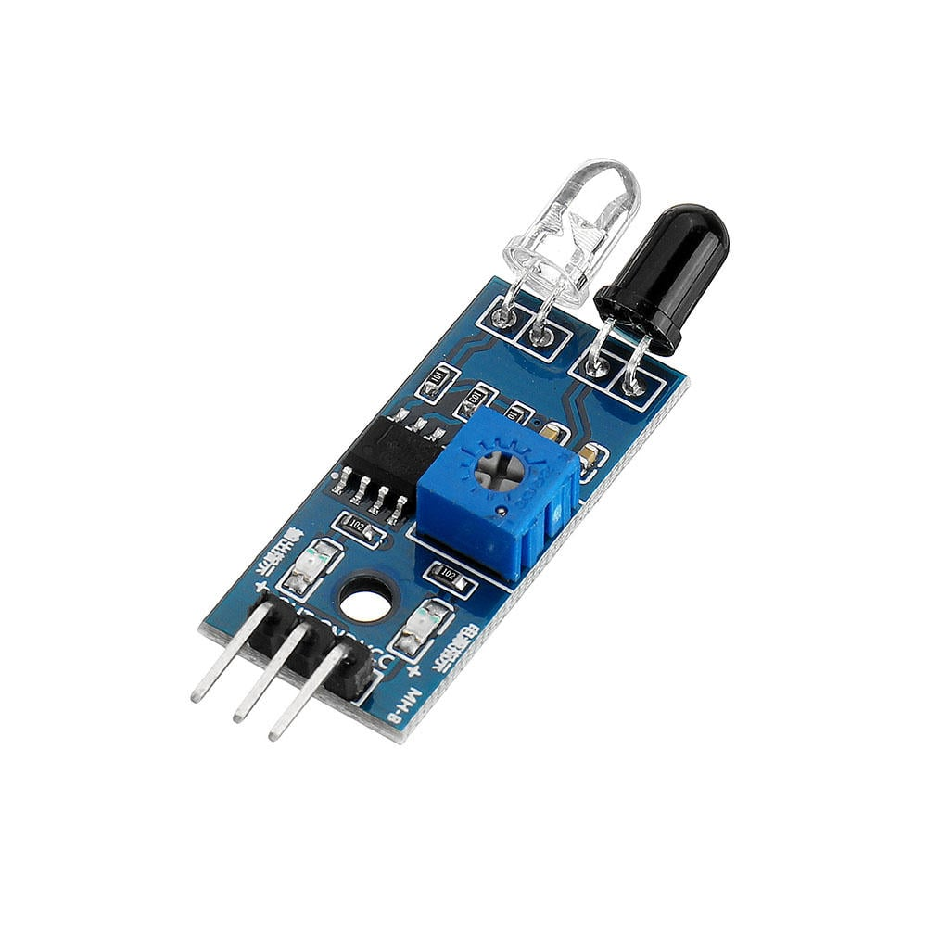
Coolant Sensor
Components Required for Data Transfer
Characteristics of LoRa
IR Sensor
Wiring
Rough Sketch of Wiring
LoRa
Data Transfer
Arduino Uno with one transceiver and various sensor inside the vehicle
It is a sensor that is used to measure the temperature of vehicle around engine.
It doesn’t directly measure the temperature.
We first find the resistance dependent of it with temperature then use voltage divider circuit with Arduino to calculate the temperature by Steinhart–Hart equation.
Long Range
LoRa (from "long range") is a physical proprietary radio communication technique. It is based on spread spectrum modulation techniques derived from chirp spread spectrum (CSS) technology.
It is a sensor that can be used to form a tachometer which can be used to measure the rotations per minute.
IR transmits IR rays which reflect back to the IR receiver and then IR Module generates an output or pulse which is detected by the Arduino controller
After 5 seconds Arduino calculates RPM for a minute using the given formula:
RPM=count x 12 / (number of spokes of wheel)
Another Arduino Uno connected with PC and one transceiver
Modulation | Chirp Spread Spectrum
Frequency | Unlicensed ISM Band (868 MHz)
Bandwidth | 250KHz and 125 KHz
Maximum Data Rate | 50 Kbps
Maximum Payload Length | 243 bytes
Spread Factor | 7 to 12
Coverage Range | 5 Km (Urban); 20 Km (Rural)
Topology | Star on Star
Adaptive Data Rate | Yes
Authentication/Encryption | Yes (AES 128b)
Allow Private Network | Yes
Standardization | LoRa-Alliance (Governing Body)
LoRa VCC to Arduino 3.3V or an external 3.3V power supply (check the module's voltage requirements).
​LoRa GND to Arduino GND.​
LoRa SCK to Arduino SCK, 13 (SCK is the SPI clock pin).​
LoRa MISO to Arduino MISO, 12(Master In Slave Out).​
LoRa MOSI to Arduino MOSI, 11 (Master Out Slave In).
​LoRa NSS (or CS) to an Arduino digital pin (e.g., D10).
​LoRa DIO0 to an Arduino digital pin (e.g., D2) - this is the interrupt pin used to receive data.​
LoRa RST (Reset) to an Arduino digital pin (e.g., D9) if available; otherwise, you can connect it directly to 3.3V.​
1. Long Range: Can transmit up to 20 kms in rural areas and 5 kms in urban settings, making it ideal for wide area loT applications.
2. Low Power: LoRa devices are energy efficient, running on batteries for many years
3. Adaptive Data Rate: Helps in optimizing energy consumption and enhances network capacity.
4. High Capacity: Can support millions of messages per base station, making it an excellent choice for dense sensor networks.
5. Secure: Built-in encryption for secure data transfer
The objective of this project is to send data of various sensors installed in the vehicle to a computer located at some another place a long distance away from the computer continuously and effectively.
The data can be temperature of various components of vehicle, fuel information, GPS location etc.
Two SX1278 LoRa Transceivers
Arduino Uno
The SX1278 transceivers feature the LoRa long range modem that provides ultra-long range spread spectrum communication and high interference immunity whilst minimizing current consumption. One will be connected to the microcontroller which is placed in the vehicle to take in the data from different sensors and one will be connected to the computer at work station.
It costs about ₹400 to 500
LoRa module product link
Helix antenna product link
Arduino UNO is a microcontroller board. It has 14 digital input/output pins (of which 6 can be used as PWM outputs), 6 analog inputs, a 16 MHz ceramic resonator, a USB connection, a power jack, an ICSP header and a reset button. It will be placed in the vehicle and various sensors and one LoRa transceiver will be connected to it. The transceiver will act as transmitter and will send data to the other transciever.
It costs about ₹300 to 400
Arduino Uno product link
We find resistance at 0,22 and 100 degree Celsius to find the constants A,B,C and then use voltage divider circuit with Arduino to calculate resistor and then find the temperature finally.
ECT has two wires, one of them will be connected to the ground and the second will be connected by the voltage-dividend. The above resistors have the values of difference of individual resistances across the wires.
ECT web address

Slide 19
Coolant Sensor
Components Required for Data Transfer
Characteristics of LoRa
IR Sensor
Wiring
Rough Sketch of Wiring
LoRa
Data Transfer
Arduino Uno with one transceiver and various sensor inside the vehicle
It is a sensor that can be used to form a tachometer which can be used to measure the rotations per minute.
IR transmits IR rays which reflect back to the IR receiver and then IR Module generates an output or pulse which is detected by the Arduino controller
After 5 seconds Arduino calculates RPM for a minute using the given formula:
RPM=count x 12 / (number of spokes of wheel)
It is a sensor that is used to measure the temperature of vehicle around engine.
It doesn’t directly measure the temperature.
We first find the resistance dependent of it with temperature then use voltage divider circuit with Arduino to calculate the temperature by Steinhart–Hart equation.
Long Range
LoRa (from "long range") is a physical proprietary radio communication technique. It is based on spread spectrum modulation techniques derived from chirp spread spectrum (CSS) technology.
Another Arduino Uno connected with PC and one transceiver
Modulation | Chirp Spread Spectrum
Frequency | Unlicensed ISM Band (868 MHz)
Bandwidth | 250KHz and 125 KHz
Maximum Data Rate | 50 Kbps
Maximum Payload Length | 243 bytes
Spread Factor | 7 to 12
Coverage Range | 5 Km (Urban); 20 Km (Rural)
Topology | Star on Star
Adaptive Data Rate | Yes
Authentication/Encryption | Yes (AES 128b)
Allow Private Network | Yes
Standardization | LoRa-Alliance (Governing Body)
LoRa VCC to Arduino 3.3V or an external 3.3V power supply (check the module's voltage requirements).
​LoRa GND to Arduino GND.​
LoRa SCK to Arduino SCK, 13 (SCK is the SPI clock pin).​
LoRa MISO to Arduino MISO, 12(Master In Slave Out).​
LoRa MOSI to Arduino MOSI, 11 (Master Out Slave In).
​LoRa NSS (or CS) to an Arduino digital pin (e.g., D10).
​LoRa DIO0 to an Arduino digital pin (e.g., D2) - this is the interrupt pin used to receive data.​
LoRa RST (Reset) to an Arduino digital pin (e.g., D9) if available; otherwise, you can connect it directly to 3.3V.​
1. Long Range: Can transmit up to 20 kms in rural areas and 5 kms in urban settings, making it ideal for wide area loT applications.
2. Low Power: LoRa devices are energy efficient, running on batteries for many years
3. Adaptive Data Rate: Helps in optimizing energy consumption and enhances network capacity.
4. High Capacity: Can support millions of messages per base station, making it an excellent choice for dense sensor networks.
5. Secure: Built-in encryption for secure data transfer
The objective of this project is to send data of various sensors installed in the vehicle to a computer located at some another place a long distance away from the computer continuously and effectively.
The data can be temperature of various components of vehicle, fuel information, GPS location etc.
Two SX1278 LoRa Transceivers
Arduino Uno
The SX1278 transceivers feature the LoRa long range modem that provides ultra-long range spread spectrum communication and high interference immunity whilst minimizing current consumption. One will be connected to the microcontroller which is placed in the vehicle to take in the data from different sensors and one will be connected to the computer at work station.
It costs about ₹400 to 500
LoRa module product link
Helix antenna product link
Arduino UNO is a microcontroller board. It has 14 digital input/output pins (of which 6 can be used as PWM outputs), 6 analog inputs, a 16 MHz ceramic resonator, a USB connection, a power jack, an ICSP header and a reset button. It will be placed in the vehicle and various sensors and one LoRa transceiver will be connected to it. The transceiver will act as transmitter and will send data to the other transciever.
It costs about ₹300 to 400
Arduino Uno product link
We find resistance at 0,22 and 100 degree Celsius to find the constants A,B,C and then use voltage divider circuit with Arduino to calculate resistor and then find the temperature finally.
ECT has two wires, one of them will be connected to the ground and the second will be connected by the voltage-dividend. The above resistors have the values of difference of individual resistances across the wires.
ECT web address

Slide 20
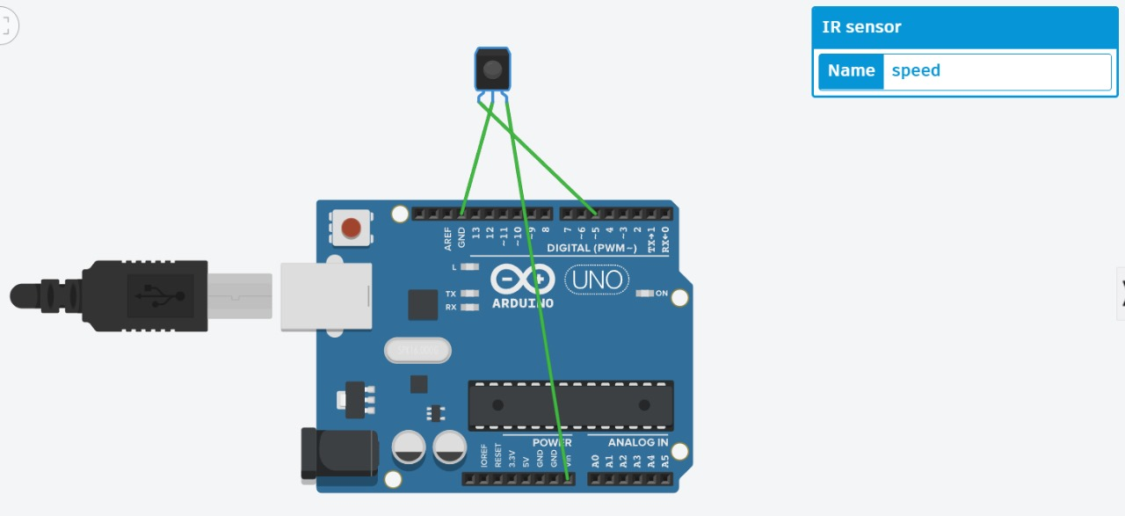
Coolant Sensor
Components Required for Data Transfer
Characteristics of LoRa
IR Sensor
Wiring
Wiring
Rough Sketch of Wiring
LoRa
Data Transfer
Arduino Uno with one transceiver and various sensor inside the vehicle
It is a sensor that can be used to form a tachometer which can be used to measure the rotations per minute.
IR transmits IR rays which reflect back to the IR receiver and then IR Module generates an output or pulse which is detected by the Arduino controller
After 5 seconds Arduino calculates RPM for a minute using the given formula:
RPM=count x 12 / (number of spokes of wheel)
It is a sensor that is used to measure the temperature of vehicle around engine.
It doesn’t directly measure the temperature.
We first find the resistance dependent of it with temperature then use voltage divider circuit with Arduino to calculate the temperature by Steinhart–Hart equation.
Long Range
LoRa (from "long range") is a physical proprietary radio communication technique. It is based on spread spectrum modulation techniques derived from chirp spread spectrum (CSS) technology.
Another Arduino Uno connected with PC and one transceiver
Modulation | Chirp Spread Spectrum
Frequency | Unlicensed ISM Band (868 MHz)
Bandwidth | 250KHz and 125 KHz
Maximum Data Rate | 50 Kbps
Maximum Payload Length | 243 bytes
Spread Factor | 7 to 12
Coverage Range | 5 Km (Urban); 20 Km (Rural)
Topology | Star on Star
Adaptive Data Rate | Yes
Authentication/Encryption | Yes (AES 128b)
Allow Private Network | Yes
Standardization | LoRa-Alliance (Governing Body)
LoRa VCC to Arduino 3.3V or an external 3.3V power supply (check the module's voltage requirements).
​LoRa GND to Arduino GND.​
LoRa SCK to Arduino SCK, 13 (SCK is the SPI clock pin).​
LoRa MISO to Arduino MISO, 12(Master In Slave Out).​
LoRa MOSI to Arduino MOSI, 11 (Master Out Slave In).
​LoRa NSS (or CS) to an Arduino digital pin (e.g., D10).
​LoRa DIO0 to an Arduino digital pin (e.g., D2) - this is the interrupt pin used to receive data.​
LoRa RST (Reset) to an Arduino digital pin (e.g., D9) if available; otherwise, you can connect it directly to 3.3V.​
1. Long Range: Can transmit up to 20 kms in rural areas and 5 kms in urban settings, making it ideal for wide area loT applications.
2. Low Power: LoRa devices are energy efficient, running on batteries for many years
3. Adaptive Data Rate: Helps in optimizing energy consumption and enhances network capacity.
4. High Capacity: Can support millions of messages per base station, making it an excellent choice for dense sensor networks.
5. Secure: Built-in encryption for secure data transfer
The objective of this project is to send data of various sensors installed in the vehicle to a computer located at some another place a long distance away from the computer continuously and effectively.
The data can be temperature of various components of vehicle, fuel information, GPS location etc.
Two SX1278 LoRa Transceivers
Arduino Uno
The SX1278 transceivers feature the LoRa long range modem that provides ultra-long range spread spectrum communication and high interference immunity whilst minimizing current consumption. One will be connected to the microcontroller which is placed in the vehicle to take in the data from different sensors and one will be connected to the computer at work station.
It costs about ₹400 to 500
LoRa module product link
Helix antenna product link
Arduino UNO is a microcontroller board. It has 14 digital input/output pins (of which 6 can be used as PWM outputs), 6 analog inputs, a 16 MHz ceramic resonator, a USB connection, a power jack, an ICSP header and a reset button. It will be placed in the vehicle and various sensors and one LoRa transceiver will be connected to it. The transceiver will act as transmitter and will send data to the other transciever.
It costs about ₹300 to 400
Arduino Uno product link
We find resistance at 0,22 and 100 degree Celsius to find the constants A,B,C and then use voltage divider circuit with Arduino to calculate resistor and then find the temperature finally.
ECT has two wires, one of them will be connected to the ground and the second will be connected by the voltage-dividend. The above resistors have the values of difference of individual resistances across the wires.
ECT web address
IR Sensor product link

Slide 21
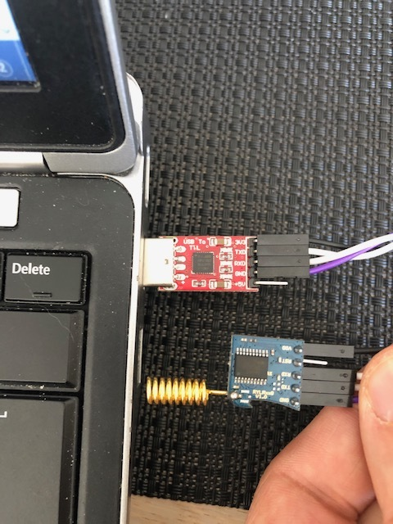
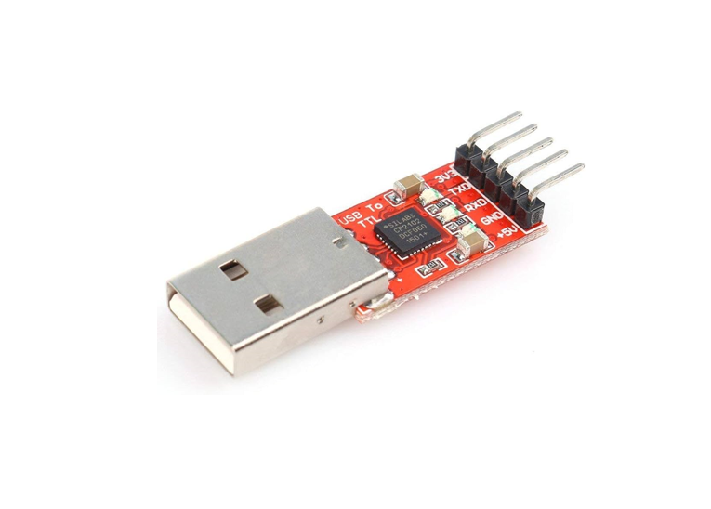
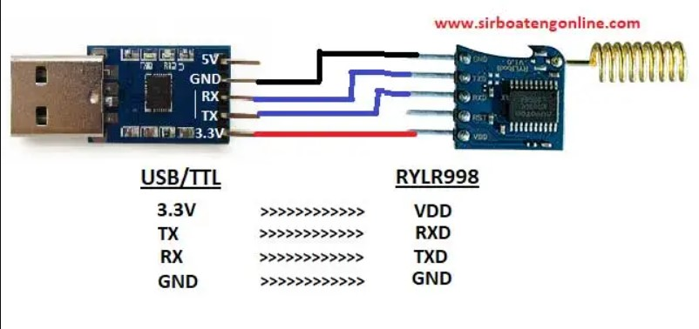
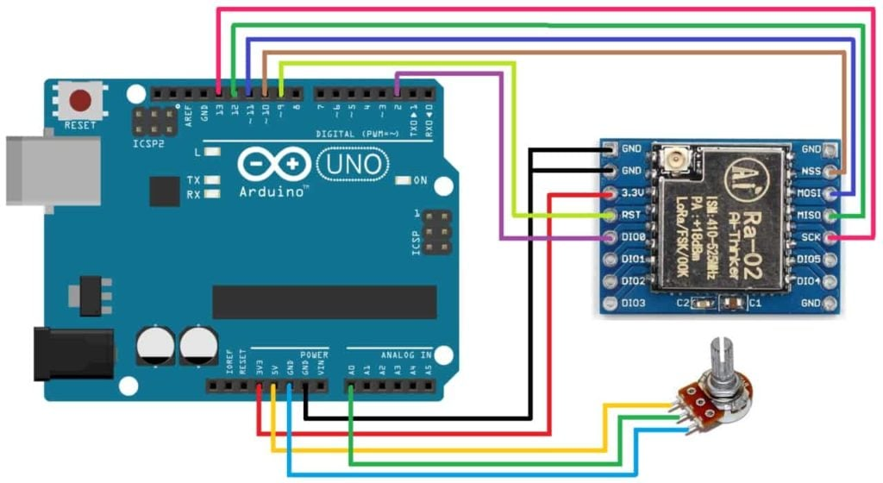
Rough Sketch of Wiring
Components Required for Data Transfer
Characteristics of LoRa
Coolant Sensor
Wiring
LoRa
IR Sensor
Data Transfer
Wiring
Arduino Uno with one transceiver and various sensor inside the vehicle
Long Range
LoRa (from "long range") is a physical proprietary radio communication technique. It is based on spread spectrum modulation techniques derived from chirp spread spectrum (CSS) technology.
It is a sensor that is used to measure the temperature of vehicle around engine.
It doesn’t directly measure the temperature.
We first find the resistance dependent of it with temperature then use voltage divider circuit with Arduino to calculate the temperature by Steinhart–Hart equation.
USB to TTL with PC and one transceiver
It is a sensor that can be used to form a tachometer which can be used to measure the rotations per minute.
IR transmits IR rays which reflect back to the IR receiver and then IR Module generates an output or pulse which is detected by the Arduino controller
After 5 seconds Arduino calculates RPM for a minute using the given formula:
RPM=count x 12 / (number of spokes of wheel)
Modulation | Chirp Spread Spectrum
Frequency | Unlicensed ISM Band (868 MHz)
Bandwidth | 250KHz and 125 KHz
Maximum Data Rate | 50 Kbps
Maximum Payload Length | 243 bytes
Spread Factor | 7 to 12
Coverage Range | 5 Km (Urban); 20 Km (Rural)
Topology | Star on Star
Adaptive Data Rate | Yes
Authentication/Encryption | Yes (AES 128b)
Allow Private Network | Yes
Standardization | LoRa-Alliance (Governing Body)
1. Long Range: Can transmit up to 20 kms in rural areas and 5 kms in urban settings, making it ideal for wide area loT applications.
2. Low Power: LoRa devices are energy efficient, running on batteries for many years
3. Adaptive Data Rate: Helps in optimizing energy consumption and enhances network capacity.
4. High Capacity: Can support millions of messages per base station, making it an excellent choice for dense sensor networks.
5. Secure: Built-in encryption for secure data transfer
The objective of this project is to send data of various sensors installed in the vehicle to a computer located at some another place a long distance away from the computer continuously and effectively.
The data can be temperature of various components of vehicle, fuel information, GPS location etc.
Two SX1278 LoRa Transceivers
Arduino Uno
USB to TTL
The SX1278 transceivers feature the LoRa long range modem that provides ultra-long range spread spectrum communication and high interference immunity whilst minimizing current consumption. One will be connected to the microcontroller which is placed in the vehicle to take in the data from different sensors and one will be connected to the computer at work station.
It costs about ₹400 to 500
Arduino UNO is a microcontroller board. It has 14 digital input/output pins (of which 6 can be used as PWM outputs), 6 analog inputs, a 16 MHz ceramic resonator, a USB connection, a power jack, an ICSP header and a reset button. It will be placed in the vehicle and various sensors and one LoRa transceiver will be connected to it. The transceiver will act as transmitter and will send data to the other transciever.
It costs about ₹300 to 400
The USB to TTL Converter allows us to connect any serial port to USB Device, thereby enabling the mobility for data transmission.It has USB 2.0 Type A Male connector on one end, and other end has pin outs for Vcc, Gnd, RX and TX.
It will be used to connect the one LoRa transceiver to the PC at workstation.
An Arduino uno can also be used in place of it.
It costs about ₹200 to 300
We find resistance at 0,22 and 100 degree Celsius to find the constants A,B,C and then use voltage divider circuit with Arduino to calculate resistor and then find the temperature finally.
Transceiver(working as receiver) connection with USB to TTL
Transceiver(working as transmitter) connection with Arduino Uno
IR Sensor product link

Slide 22
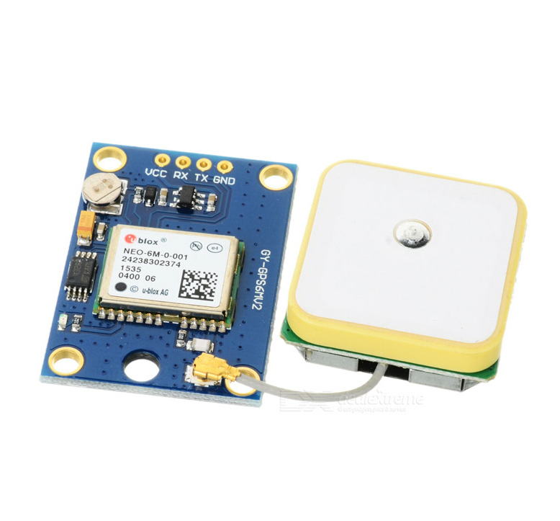
Rough Sketch of Wiring
Components Required for Data Transfer
Characteristics of LoRa
Coolant Sensor
Wiring
NEO-6M GPS
LoRa
IR Sensor
Data Transfer
Wiring
Arduino Uno with one transceiver and various sensor inside the vehicle
Long Range
LoRa (from "long range") is a physical proprietary radio communication technique. It is based on spread spectrum modulation techniques derived from chirp spread spectrum (CSS) technology.
It is a sensor that is used to get the geolocation data.
Along with latitude and longitude it gives data like number of satellites being tracked, horizontal dilution of position, altitude above mean sea level, height of geoid respectively
Its output looks like:
$GPGGA,110617.00,41XX.XXXXX,N,00831.54761,W,1,05,2.68,129.0,M,50.1,M,,*42
It is a sensor that is used to measure the temperature of vehicle around engine.
It doesn’t directly measure the temperature.
We first find the resistance dependent of it with temperature then use voltage divider circuit with Arduino to calculate the temperature by Steinhart–Hart equation.
USB to TTL with PC and one transceiver
It is a sensor that can be used to form a tachometer which can be used to measure the rotations per minute.
IR transmits IR rays which reflect back to the IR receiver and then IR Module generates an output or pulse which is detected by the Arduino controller
After 5 seconds Arduino calculates RPM for a minute using the given formula:
RPM=count x 12 / (number of spokes of wheel)
Modulation | Chirp Spread Spectrum
Frequency | Unlicensed ISM Band (868 MHz)
Bandwidth | 250KHz and 125 KHz
Maximum Data Rate | 50 Kbps
Maximum Payload Length | 243 bytes
Spread Factor | 7 to 12
Coverage Range | 5 Km (Urban); 20 Km (Rural)
Topology | Star on Star
Adaptive Data Rate | Yes
Authentication/Encryption | Yes (AES 128b)
Allow Private Network | Yes
Standardization | LoRa-Alliance (Governing Body)
1. Long Range: Can transmit up to 20 kms in rural areas and 5 kms in urban settings, making it ideal for wide area loT applications.
2. Low Power: LoRa devices are energy efficient, running on batteries for many years
3. Adaptive Data Rate: Helps in optimizing energy consumption and enhances network capacity.
4. High Capacity: Can support millions of messages per base station, making it an excellent choice for dense sensor networks.
5. Secure: Built-in encryption for secure data transfer
The objective of this project is to send data of various sensors installed in the vehicle to a computer located at some another place a long distance away from the computer continuously and effectively.
The data can be temperature of various components of vehicle, fuel information, GPS location etc.
Two SX1278 LoRa Transceivers
Arduino Uno
USB to TTL
The SX1278 transceivers feature the LoRa long range modem that provides ultra-long range spread spectrum communication and high interference immunity whilst minimizing current consumption. One will be connected to the microcontroller which is placed in the vehicle to take in the data from different sensors and one will be connected to the computer at work station.
It costs about ₹400 to 500
Arduino UNO is a microcontroller board. It has 14 digital input/output pins (of which 6 can be used as PWM outputs), 6 analog inputs, a 16 MHz ceramic resonator, a USB connection, a power jack, an ICSP header and a reset button. It will be placed in the vehicle and various sensors and one LoRa transceiver will be connected to it. The transceiver will act as transmitter and will send data to the other transciever.
It costs about ₹300 to 400
The USB to TTL Converter allows us to connect any serial port to USB Device, thereby enabling the mobility for data transmission.It has USB 2.0 Type A Male connector on one end, and other end has pin outs for Vcc, Gnd, RX and TX.
It will be used to connect the one LoRa transceiver to the PC at workstation.
An Arduino uno can also be used in place of it.
It costs about ₹200 to 300
We find resistance at 0,22 and 100 degree Celsius to find the constants A,B,C and then use voltage divider circuit with Arduino to calculate resistor and then find the temperature finally.
Transceiver(working as receiver) connection with USB to TTL
Transceiver(working as transmitter) connection with Arduino Uno
IR Sensor product link

Slide 23
Rough Sketch of Wiring
Components Required for Data Transfer
Characteristics of LoRa
Wiring
Coolant Sensor
NEO-6M GPS
Wiring
LoRa
IR Sensor
Data Transfer
Arduino Uno with one transceiver and various sensor inside the vehicle
Long Range
LoRa (from "long range") is a physical proprietary radio communication technique. It is based on spread spectrum modulation techniques derived from chirp spread spectrum (CSS) technology.
It is a sensor that is used to get the geolocation data.
Along with latitude and longitude it gives data like number of satellites being tracked, horizontal dilution of position, altitude above mean sea level, height of geoid respectively
Its output looks like:
$GPGGA,110617.00,41XX.XXXXX,N,00831.54761,W,1,05,2.68,129.0,M,50.1,M,,*42
It is a sensor that is used to measure the temperature of vehicle around engine.
It doesn’t directly measure the temperature.
We first find the resistance dependent of it with temperature then use voltage divider circuit with Arduino to calculate the temperature by Steinhart–Hart equation.
USB to TTL with PC and one transceiver
It is a sensor that can be used to form a tachometer which can be used to measure the rotations per minute.
IR transmits IR rays which reflect back to the IR receiver and then IR Module generates an output or pulse which is detected by the Arduino controller
After 5 seconds Arduino calculates RPM for a minute using the given formula:
RPM=count x 12 / (number of spokes of wheel)
Modulation | Chirp Spread Spectrum
Frequency | Unlicensed ISM Band (868 MHz)
Bandwidth | 250KHz and 125 KHz
Maximum Data Rate | 50 Kbps
Maximum Payload Length | 243 bytes
Spread Factor | 7 to 12
Coverage Range | 5 Km (Urban); 20 Km (Rural)
Topology | Star on Star
Adaptive Data Rate | Yes
Authentication/Encryption | Yes (AES 128b)
Allow Private Network | Yes
Standardization | LoRa-Alliance (Governing Body)
1. Long Range: Can transmit up to 20 kms in rural areas and 5 kms in urban settings, making it ideal for wide area loT applications.
2. Low Power: LoRa devices are energy efficient, running on batteries for many years
3. Adaptive Data Rate: Helps in optimizing energy consumption and enhances network capacity.
4. High Capacity: Can support millions of messages per base station, making it an excellent choice for dense sensor networks.
5. Secure: Built-in encryption for secure data transfer
The objective of this project is to send data of various sensors installed in the vehicle to a computer located at some another place a long distance away from the computer continuously and effectively.
The data can be temperature of various components of vehicle, fuel information, GPS location etc.
Two SX1278 LoRa Transceivers
Arduino Uno
USB to TTL
The SX1278 transceivers feature the LoRa long range modem that provides ultra-long range spread spectrum communication and high interference immunity whilst minimizing current consumption. One will be connected to the microcontroller which is placed in the vehicle to take in the data from different sensors and one will be connected to the computer at work station.
It costs about ₹400 to 500
Arduino UNO is a microcontroller board. It has 14 digital input/output pins (of which 6 can be used as PWM outputs), 6 analog inputs, a 16 MHz ceramic resonator, a USB connection, a power jack, an ICSP header and a reset button. It will be placed in the vehicle and various sensors and one LoRa transceiver will be connected to it. The transceiver will act as transmitter and will send data to the other transciever.
It costs about ₹300 to 400
The USB to TTL Converter allows us to connect any serial port to USB Device, thereby enabling the mobility for data transmission.It has USB 2.0 Type A Male connector on one end, and other end has pin outs for Vcc, Gnd, RX and TX.
It will be used to connect the one LoRa transceiver to the PC at workstation.
An Arduino uno can also be used in place of it.
It costs about ₹200 to 300
We find resistance at 0,22 and 100 degree Celsius to find the constants A,B,C and then use voltage divider circuit with Arduino to calculate resistor and then find the temperature finally.
Transceiver(working as receiver) connection with USB to TTL
Transceiver(working as transmitter) connection with Arduino Uno

Slide 24
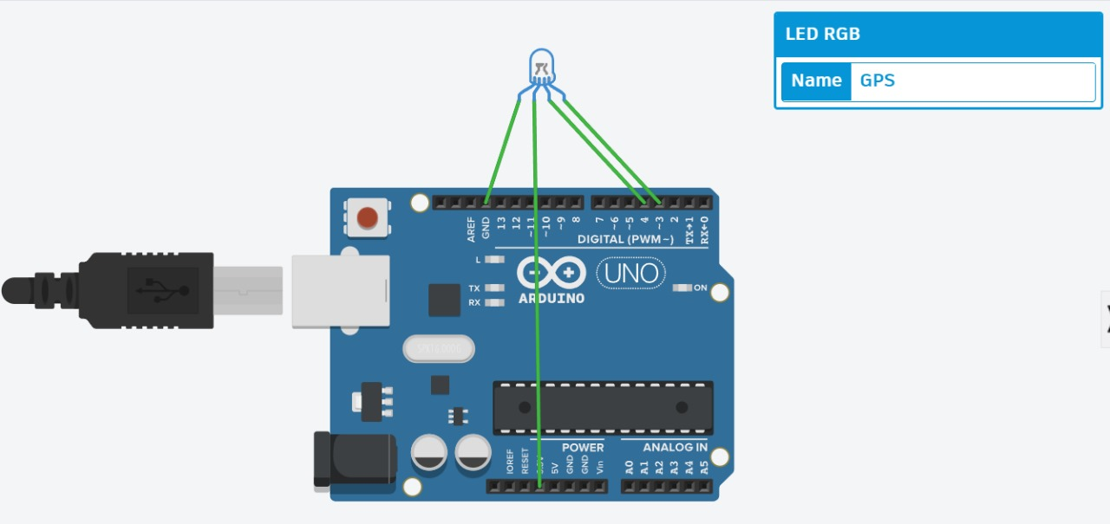
Rough Sketch of Wiring
Components Required for Data Transfer
Characteristics of LoRa
Wiring
Wiring
Coolant Sensor
NEO-6M GPS
Wiring
LoRa
IR Sensor
Data Transfer
Arduino Uno with one transceiver and various sensor inside the vehicle
Long Range
LoRa (from "long range") is a physical proprietary radio communication technique. It is based on spread spectrum modulation techniques derived from chirp spread spectrum (CSS) technology.
It is a sensor that is used to get the geolocation data.
Along with latitude and longitude it gives data like number of satellites being tracked, horizontal dilution of position, altitude above mean sea level, height of geoid respectively
Its output looks like:
$GPGGA,110617.00,41XX.XXXXX,N,00831.54761,W,1,05,2.68,129.0,M,50.1,M,,*42
It is a sensor that is used to measure the temperature of vehicle around engine.
It doesn’t directly measure the temperature.
We first find the resistance dependent of it with temperature then use voltage divider circuit with Arduino to calculate the temperature by Steinhart–Hart equation.
USB to TTL with PC and one transceiver
It is a sensor that can be used to form a tachometer which can be used to measure the rotations per minute.
IR transmits IR rays which reflect back to the IR receiver and then IR Module generates an output or pulse which is detected by the Arduino controller
After 5 seconds Arduino calculates RPM for a minute using the given formula:
RPM=count x 12 / (number of spokes of wheel)
Modulation | Chirp Spread Spectrum
Frequency | Unlicensed ISM Band (868 MHz)
Bandwidth | 250KHz and 125 KHz
Maximum Data Rate | 50 Kbps
Maximum Payload Length | 243 bytes
Spread Factor | 7 to 12
Coverage Range | 5 Km (Urban); 20 Km (Rural)
Topology | Star on Star
Adaptive Data Rate | Yes
Authentication/Encryption | Yes (AES 128b)
Allow Private Network | Yes
Standardization | LoRa-Alliance (Governing Body)
1. Long Range: Can transmit up to 20 kms in rural areas and 5 kms in urban settings, making it ideal for wide area loT applications.
2. Low Power: LoRa devices are energy efficient, running on batteries for many years
3. Adaptive Data Rate: Helps in optimizing energy consumption and enhances network capacity.
4. High Capacity: Can support millions of messages per base station, making it an excellent choice for dense sensor networks.
5. Secure: Built-in encryption for secure data transfer
The objective of this project is to send data of various sensors installed in the vehicle to a computer located at some another place a long distance away from the computer continuously and effectively.
The data can be temperature of various components of vehicle, fuel information, GPS location etc.
Two SX1278 LoRa Transceivers
Arduino Uno
USB to TTL
The SX1278 transceivers feature the LoRa long range modem that provides ultra-long range spread spectrum communication and high interference immunity whilst minimizing current consumption. One will be connected to the microcontroller which is placed in the vehicle to take in the data from different sensors and one will be connected to the computer at work station.
It costs about ₹400 to 500
Arduino UNO is a microcontroller board. It has 14 digital input/output pins (of which 6 can be used as PWM outputs), 6 analog inputs, a 16 MHz ceramic resonator, a USB connection, a power jack, an ICSP header and a reset button. It will be placed in the vehicle and various sensors and one LoRa transceiver will be connected to it. The transceiver will act as transmitter and will send data to the other transciever.
It costs about ₹300 to 400
The USB to TTL Converter allows us to connect any serial port to USB Device, thereby enabling the mobility for data transmission.It has USB 2.0 Type A Male connector on one end, and other end has pin outs for Vcc, Gnd, RX and TX.
It will be used to connect the one LoRa transceiver to the PC at workstation.
An Arduino uno can also be used in place of it.
It costs about ₹200 to 300
We find resistance at 0,22 and 100 degree Celsius to find the constants A,B,C and then use voltage divider circuit with Arduino to calculate resistor and then find the temperature finally.
Transceiver(working as receiver) connection with USB to TTL
Transceiver(working as transmitter) connection with Arduino Uno
NEO-6M GPS product link

Slide 25
Rough Sketch of Wiring
Wiring
Components Required for Data Transfer
Characteristics of LoRa
Wiring
Coolant Sensor
NEO-6M GPS
Wiring
LoRa
IR Sensor
Data Transfer
Arduino Uno with one transceiver and various sensor inside the vehicle
Long Range
LoRa (from "long range") is a physical proprietary radio communication technique. It is based on spread spectrum modulation techniques derived from chirp spread spectrum (CSS) technology.
It is a sensor that is used to get the geolocation data.
Along with latitude and longitude it gives data like number of satellites being tracked, horizontal dilution of position, altitude above mean sea level, height of geoid respectively
Its output looks like:
$GPGGA,110617.00,41XX.XXXXX,N,00831.54761,W,1,05,2.68,129.0,M,50.1,M,,*42
It is a sensor that is used to measure the temperature of vehicle around engine.
It doesn’t directly measure the temperature.
We first find the resistance dependent of it with temperature then use voltage divider circuit with Arduino to calculate the temperature by Steinhart–Hart equation.
USB to TTL with PC and one transceiver
It is a sensor that can be used to form a tachometer which can be used to measure the rotations per minute.
IR transmits IR rays which reflect back to the IR receiver and then IR Module generates an output or pulse which is detected by the Arduino controller
After 5 seconds Arduino calculates RPM for a minute using the given formula:
RPM=count x 12 / (number of spokes of wheel)
Modulation | Chirp Spread Spectrum
Frequency | Unlicensed ISM Band (868 MHz)
Bandwidth | 250KHz and 125 KHz
Maximum Data Rate | 50 Kbps
Maximum Payload Length | 243 bytes
Spread Factor | 7 to 12
Coverage Range | 5 Km (Urban); 20 Km (Rural)
Topology | Star on Star
Adaptive Data Rate | Yes
Authentication/Encryption | Yes (AES 128b)
Allow Private Network | Yes
Standardization | LoRa-Alliance (Governing Body)
1. Long Range: Can transmit up to 20 kms in rural areas and 5 kms in urban settings, making it ideal for wide area loT applications.
2. Low Power: LoRa devices are energy efficient, running on batteries for many years
3. Adaptive Data Rate: Helps in optimizing energy consumption and enhances network capacity.
4. High Capacity: Can support millions of messages per base station, making it an excellent choice for dense sensor networks.
5. Secure: Built-in encryption for secure data transfer
The objective of this project is to send data of various sensors installed in the vehicle to a computer located at some another place a long distance away from the computer continuously and effectively.
The data can be temperature of various components of vehicle, fuel information, GPS location etc.
Two SX1278 LoRa Transceivers
Arduino Uno
USB to TTL
The SX1278 transceivers feature the LoRa long range modem that provides ultra-long range spread spectrum communication and high interference immunity whilst minimizing current consumption. One will be connected to the microcontroller which is placed in the vehicle to take in the data from different sensors and one will be connected to the computer at work station.
It costs about ₹400 to 500
Arduino UNO is a microcontroller board. It has 14 digital input/output pins (of which 6 can be used as PWM outputs), 6 analog inputs, a 16 MHz ceramic resonator, a USB connection, a power jack, an ICSP header and a reset button. It will be placed in the vehicle and various sensors and one LoRa transceiver will be connected to it. The transceiver will act as transmitter and will send data to the other transciever.
It costs about ₹300 to 400
The USB to TTL Converter allows us to connect any serial port to USB Device, thereby enabling the mobility for data transmission.It has USB 2.0 Type A Male connector on one end, and other end has pin outs for Vcc, Gnd, RX and TX.
It will be used to connect the one LoRa transceiver to the PC at workstation.
An Arduino uno can also be used in place of it.
It costs about ₹200 to 300
We find resistance at 0,22 and 100 degree Celsius to find the constants A,B,C and then use voltage divider circuit with Arduino to calculate resistor and then find the temperature finally.
Transceiver(working as receiver) connection with USB to TTL
Transceiver(working as transmitter) connection with Arduino Uno
NEO-6M GPS product link

